Slide 1

#LifeKoKaroLift
Lending Club Case Study

Slide 2
Problem Statement
Lending Club company is the largest online loan marketplace, facilitating personal loans, business loans, and financing of medical procedures. Borrowers can easily access lower interest rate loans through a fast online interface.
Company wants to understand the driving factors (or driver variables) behind loan default, i.e. the variables which are strong indicators of default. The company can utilise this knowledge for its portfolio and risk assessment.

Slide 3
Data Sourcing
Downloaded the dataset from upGrad Learning page.
It contains the complete loan data for all loans issued through the time period 2007 t0 2011.

Slide 4
Data Cleaning
All the Loan behavior variables are removed as per the suggestion.
All the columns with same values in all the rows are removed.
Column ‘url ’ is removed as it does not have any significant values.
Removed the string ‘years’ and ‘year’ from the column ‘emp_length’ for better analysis.
Removed the special characters ‘+’ and ‘<’ from the column ‘emp_length’

Slide 5
Univariate Analysis
Columns like grade, subgrade, emp_length, home_ownership, purpose and addr_state are analyzed.
Employees in grades ‘B’, ‘C’ and ‘D’ are Charged Off more compared to other grades.
Employees over 1 year or less than 1 year and employees over 10+ years experience are charged off.

Slide 6
Univariate Analysis[contd..]
Employees who does not own house are Charged Off more.
Most of the employees applied loan for debt consolidation(purpose).

Slide 7
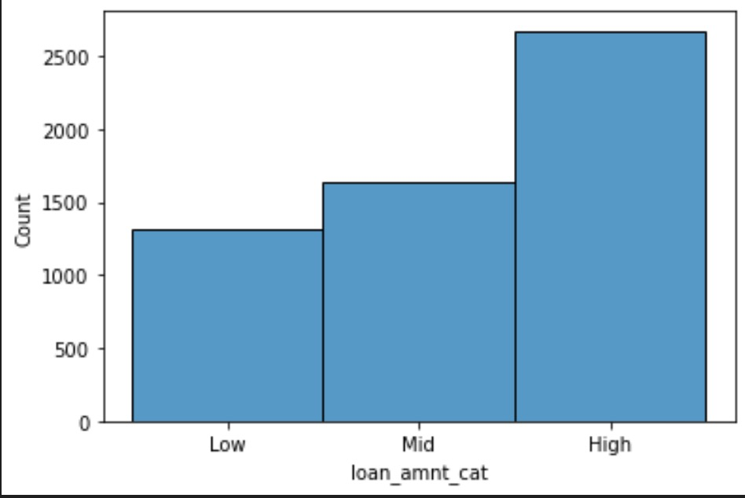
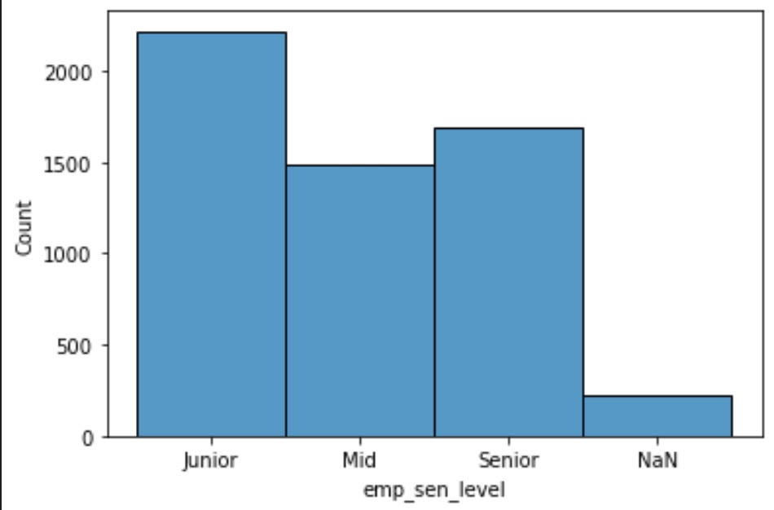
Segmented Univariate Analysis
Columns like loan_amnt, emp_length, dti are analyzed.
Employees who took loan amount more than 10K are Charged Off more.
Junior employees are Charged Off more.

Slide 8
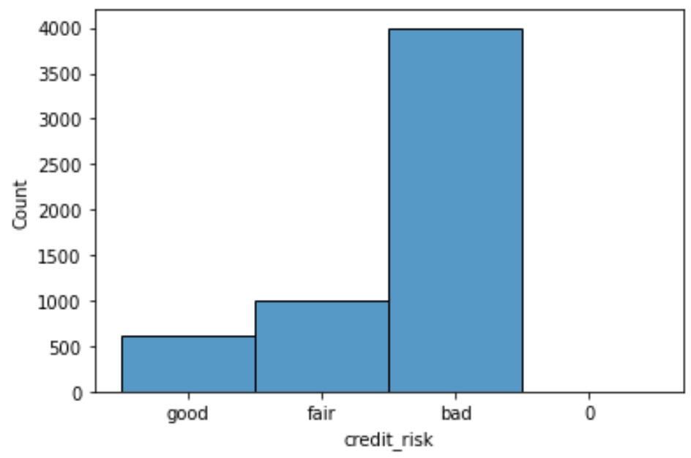
Segmented Univariate Analysis [contd.]
4) Employees with bad Credit Risk are Charged Off more.

Slide 9
Bivariate Analysis
Columns like loan_ratio(loan_amnt/annual_inc) and emp_length are analysed. Employees whose experience is of 1 or less than 1 year and 10+ years are defaulting more when they took less loan amount lesser than 10K

Slide 10
Bivariate Analysis[contd..]
Columns like emp_length(Seniority) and Purpose are analysed. In all the levels of employees, employees who took loan for debt_consolidation are default more.

Slide 11
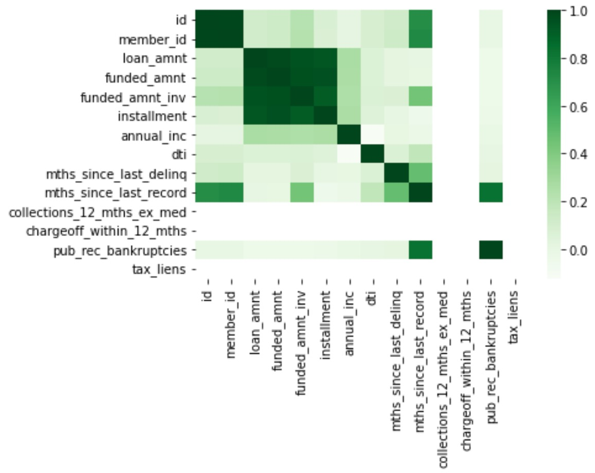
Multivariate Analysis
HeatMap is created to understand the correlation among other variables among Fully Paid employees.

Slide 12
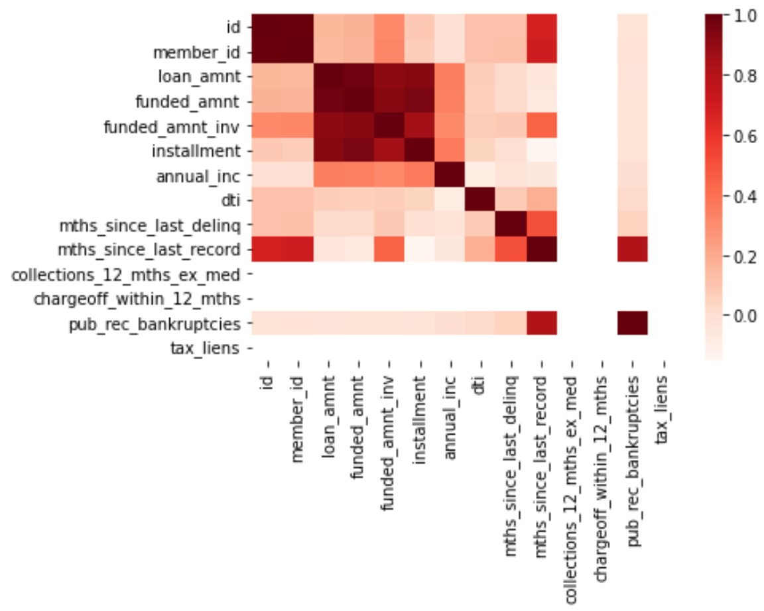
Multivariate Analysis[contd..]
2) Heatmap is created to understand the correlation among other variables among Charged Off employees.

